Slide 1


Chukwuemeka Okoli
2nd December 2021

Slide 2

Outline
Executive Summary
Introduction
Methodology
Results
Conclusion
Appendix

Slide 3
Executive Summary
Summary of methodologies
Data Collection through API
Data Collection with Web Scraping
Data Wrangling
Exploratory Data Analysis with SQL
Exploratory Data Analysis with Data Visualization
Interactive Visual Analytics with Folium
Machine Learning Prediction
Summary of all results
Exploratory Data Analysis result
Interactive analytics in screenshots
Predictive Analytics result

Slide 4
Introduction
Project background and context
Space X advertises Falcon 9 rocket launches on its website with a cost of 62 million dollars; other providers cost upward of 165 million dollars each, much of the savings is because Space X can reuse the first stage. Therefore, if we can determine if the first stage will land, we can determine the cost of a launch. This information can be used if an alternate company wants to bid against space X for a rocket launch. This goal of the project is to create a machine learning pipeline to predict if the first stage will land successfully.
Problems you want to find answers
What factors determine if the rocket will land successfully?
The interaction amongst various features that determine the success rate of a successful landing.
What operating conditions needs to be in place to ensure a successful landing program.

Slide 5


Slide 6
Methodology
Executive Summary
Data collection methodology:
Data was collected using SpaceX API and web scraping from Wikipedia.
Perform data wrangling
One-hot encoding was applied to categorical features
Perform exploratory data analysis (EDA) using visualization and SQL
Perform interactive visual analytics using Folium and Plotly Dash
Perform predictive analysis using classification models
How to build, tune, evaluate classification models

Slide 7
Data Collection
Describe how data sets were collected.
Use request() on API from Space X
Webscrape Wiki for launch records
Extract and Create Data frame using Beautiful Soup
Decode response content as json file to be converted into a pandas dataframe with .json_normalize()
The goal was to extract the launch records as HTML table, parse the table and convert to pandas DF(dataframe).

Slide 8
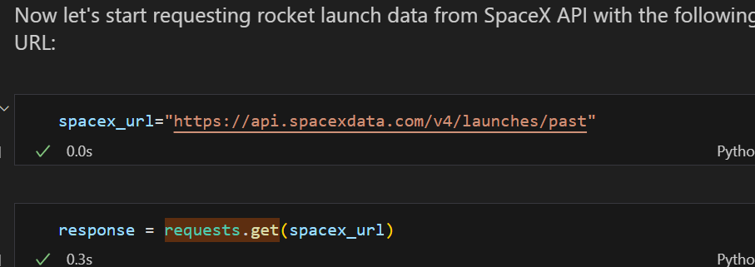
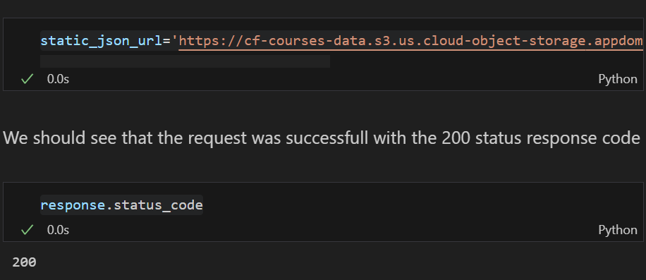
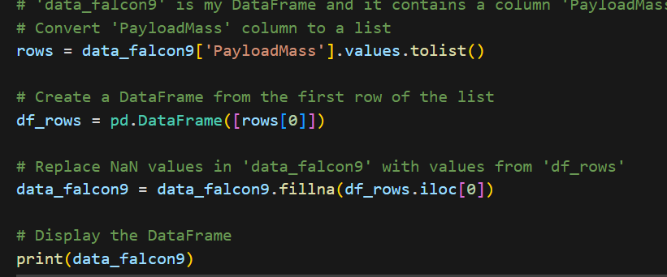
Data Collection – SpaceX API
To gather data, sanitize the requested data, and do some simple data wrangling and formatting, we used the get request to the SpaceX API.
The GitHub Link for the code is in https://github.com/Neuromanxer/DataSciCapstone

Slide 9
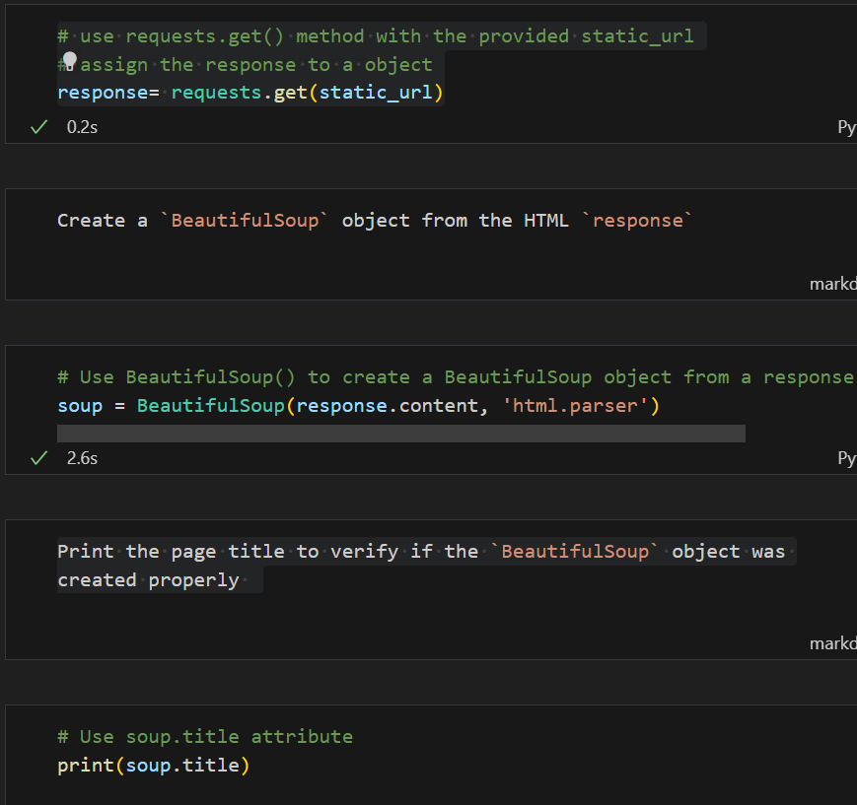
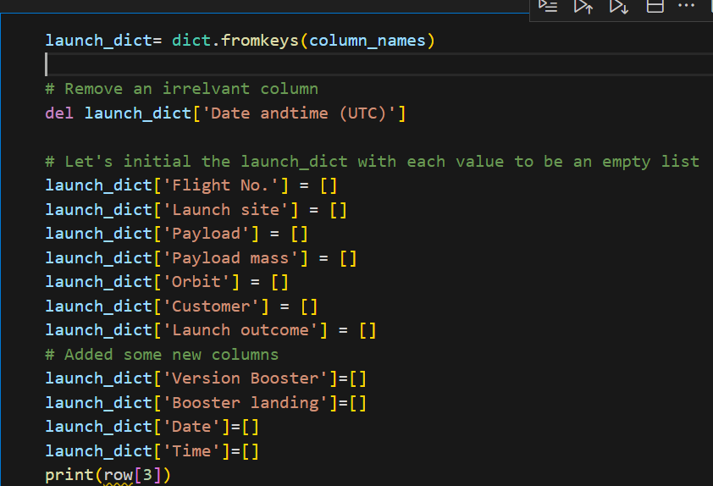
Data Collection - Scraping
We applied web scrapping to webscrap Falcon 9 launch records with BeautifulSoup
We parsed the table and converted it into a pandas dataframe.
The GitHub Link for the code notebook is in https://github.com/Neuromanxer/DataSciCapstone

Slide 10
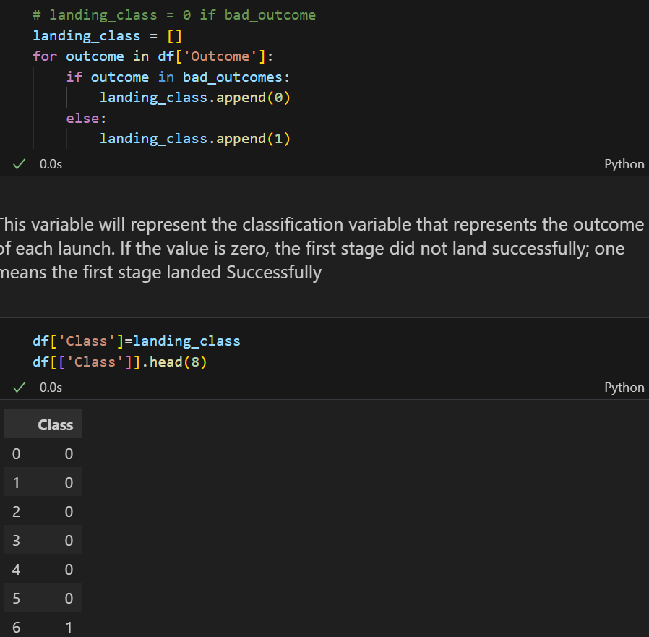
Data Wrangling
Finally, we gathered data and did initial data exploration as well as identifying the training labels.
By the quantity of launches taking place we counted the number of launch sites and each particular number and occurrence of each orbits
From the outcome column, we made a new label named – ‘Landing Outcome Label’ and then saved the results into csv.
Link to Notebook: https://github.com/Neuromanxer/DataSciCapstone

Slide 11
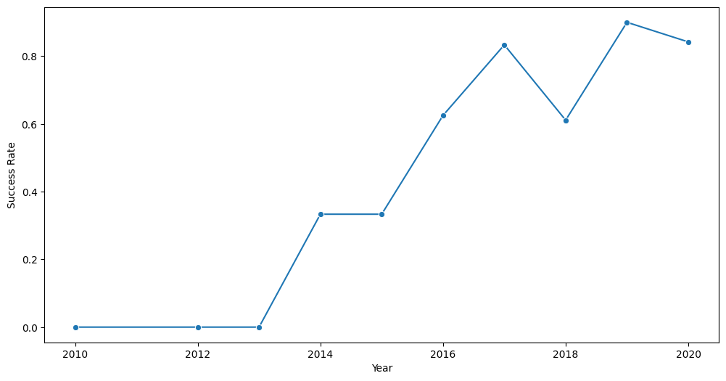
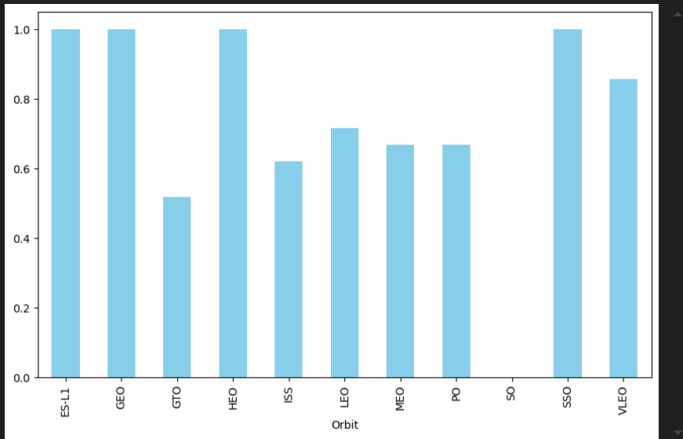
EDA with Data Visualization
We explored the data by visualizing the relationship between flight number and launch Site, payload and launch site, success rate of each orbit type, flight number and orbit type, the launch success yearly trend.
The link to the notebook is https://github.com/chuksoo/IBM-Data-Science-Capstone-SpaceX/blob/main/EDA%20with%20Data%20Visualization.ipynb

Slide 12
EDA with SQL
When using Postgres, it is critical that the SpaceX dataset be uploaded to the database without having to leave the Jupyter notebook. We also did EDA using SQL query to understand something out of data. We wrote queries to find out for instance:We wrote queries to find out for instance: - The name of the spaces launch sites particularly for the first time. - NASA CRS boosters’ total payload mass refers to the amount of total mass each booster is designed to carry to orbit. - From it one can rework out an average payload mass handled by booster version F9 v1. 1
Overall, it is also important to focus on the number of missions that have been successfully completed with those that were unsuccessful. The following are the failed landing outcomes in drone ship, their booster version, and the launch site it originated from. The link to the notebook is https:they are involved /mainly stored at GitHub: com/chuksoo/IBM-Data-Science-Capstone-SpaceX/blob/main/EDA%20with%20SQL. ipynb

Slide 13
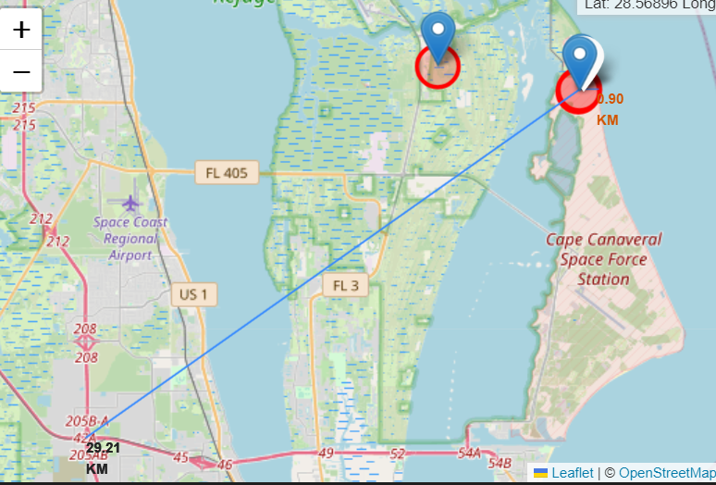
Build an Interactive Map with Folium
We identified and labeled the launch sites and included other points such as markers, circles and lines to indicate whether the launches of the respective site on the folium map were successful or not.
To do that, we labeled the feature launch outcome as either a failure or success and categorized them as class 0 and class 1, respectively. This is because the number of successful treatment is compared with the number of failures where 0 represents failure and 1 represents success.
Focusing on the clusters assessed by the color-labeled markers, it is possible to define those launch sites that were characterized by a high proportion of successful outcomes.
We did actual computations of the distances from a given launch site to its nearrens. We answered some question for instance:We answered some question for instance:
Can you tell if launch sites are near railways, highways and coasts?

Slide 14
We used Plotly dash to create an interactive dashboard. We created pie charts that displayed each site's total launches. For each booster version, we created a scatter graph that displayed the link between the outcome and payload mass (kg).
Build a Dashboard with Plotly Dash
We built an interactive dashboard with Plotly dash
We plotted pie charts showing the total launches by a certain sites
We plotted scatter graph showing the relationship with Outcome and Payload Mass (Kg) for the different booster version.
The link to the notebook is https://github.com/Neuromanxer/DataSciCapstone

Slide 15
Predictive Analysis (Classification)
•At this stage we converted, loaded our data through numpy and pandas then we transmuted our data and also divided our data into training and testing. •We constructed different machine learning models and adjust the various parameters with GridSearchCV. •We had to conduct a study from which we identified our model’s accuracy for analysis and made enhancements on the model through introducing additional features and tuning the algorithm. •The final combination of the textual and visual features helped us in finding the best performing classification model. - Link to GITHUB: https://github.com/Neuromanxer/DataSciCapstone

Slide 16
Results
Exploratory data analysis results
Interactive analytics demo in screenshots
Predictive analysis results

Slide 17


Slide 18
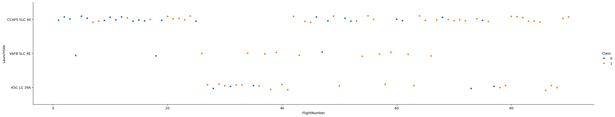
Flight Number vs. Launch Site
We deduced from the plot that a launch site's success rate increases with the number of flighs conducted there.

Slide 19

Payload vs. Launch Site
Payload mass was proportionate to the success rate of the rocket.

Slide 20
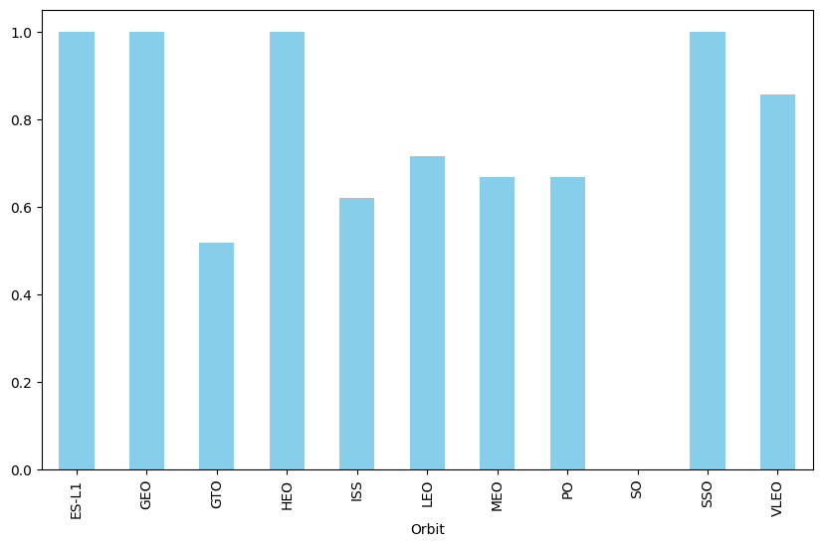
Success Rate vs. Orbit Type
ES-L1, GEO, HEO, SSO, VLEO had the most success rate.

Slide 21
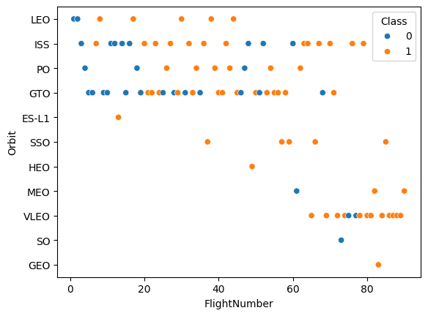
Flight Number vs. Orbit Type
The Flight Number vs. Orbit type figure is presented below. We see that while there is no correlation between flight number and orbit in the GTO orbit, success in the LEO orbit is correlated with the number of flights.

Slide 22
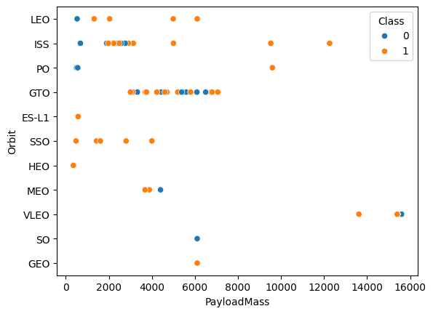
Payload vs. Orbit Type
The successful landing happens more frequently in PO, LEO and ISS orbits.

Slide 23
Launch Success Yearly Trend
Success rate since 2013 kept on increasing till 2020.

Slide 24
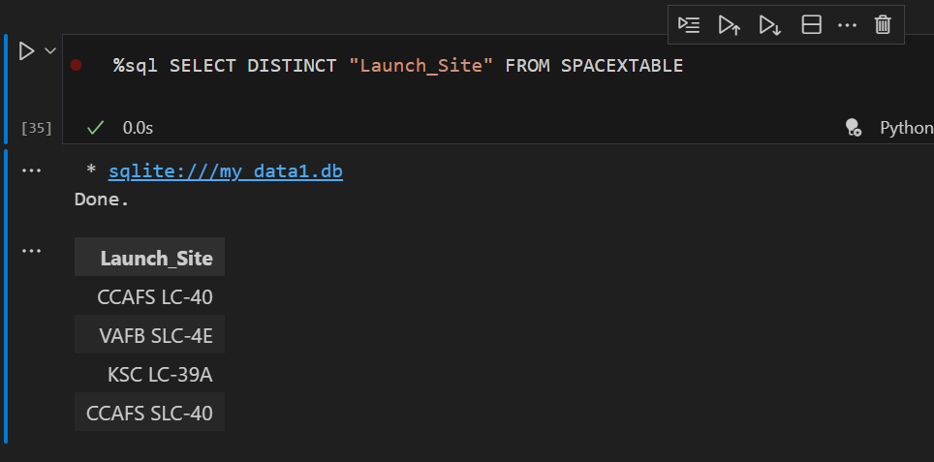
All Launch Site Names
Using the key word DISTINCT to show unique launch sites from the SpaceX data.

Slide 25
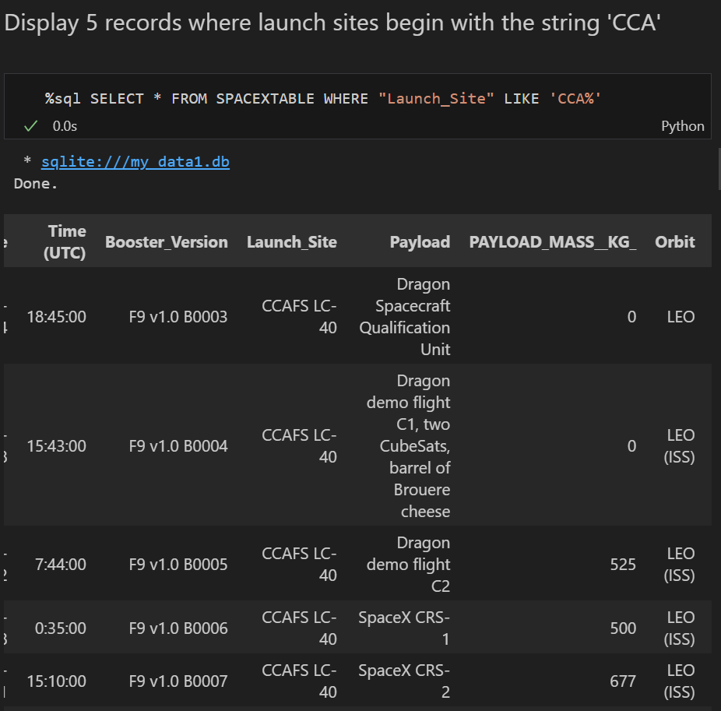
Launch Site Names Begin with 'CCA'
I used this query above to display 5 records where launch sites begin with `CCA`

Slide 26
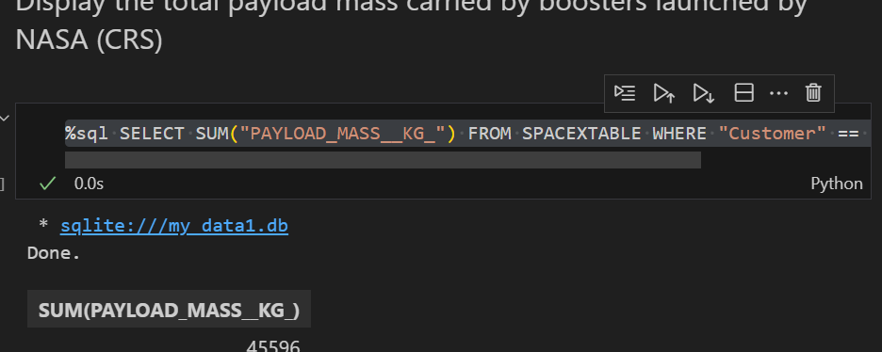
Total Payload Mass
The total payload mass carried by boosters from NASA as 45596 using the query below

Slide 27
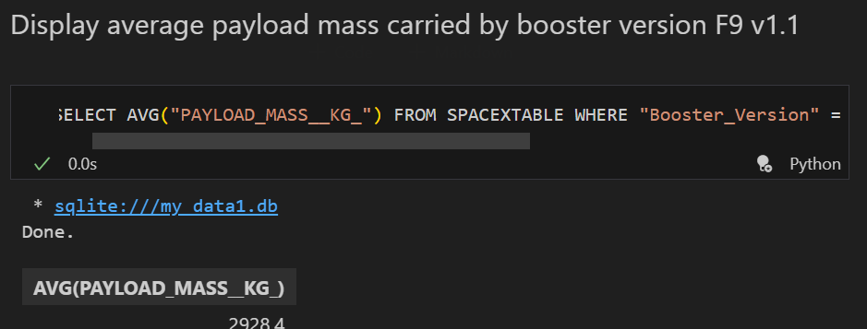
Average Payload Mass by F9 v1.1
The average payload mass carried by booster version F9 v1.1 is 2928.4

Slide 28
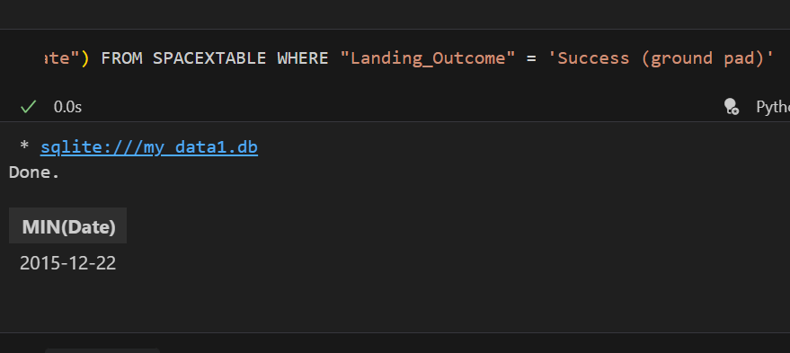
First Successful Ground Landing Date
Tdates of the first successful landing outcome on ground pad was 22nd December 2015

Slide 29
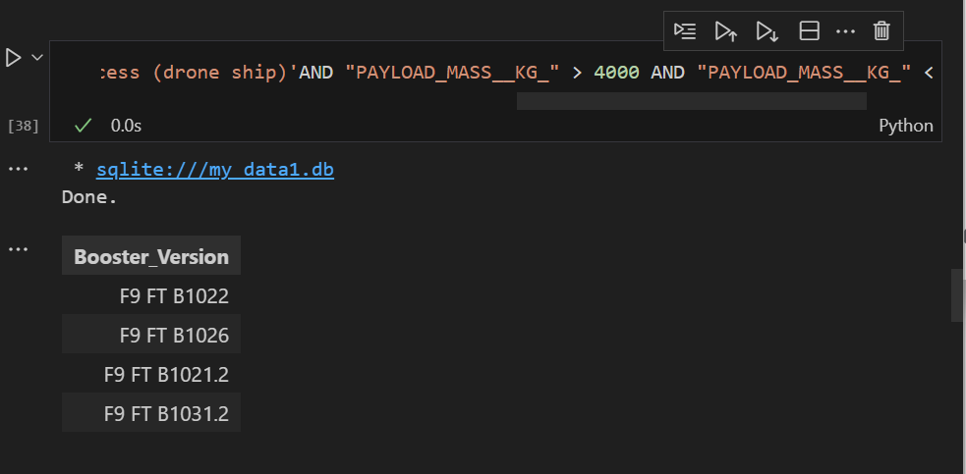
Successful Drone Ship Landing with Payload between 4000 and 6000
In order to identify successful landings with payload masses larger than 4000 but less an 6000, we employed the AND condition after using the WHERE clause to filter for boosters that have successfully landed on drone ships.

Slide 30
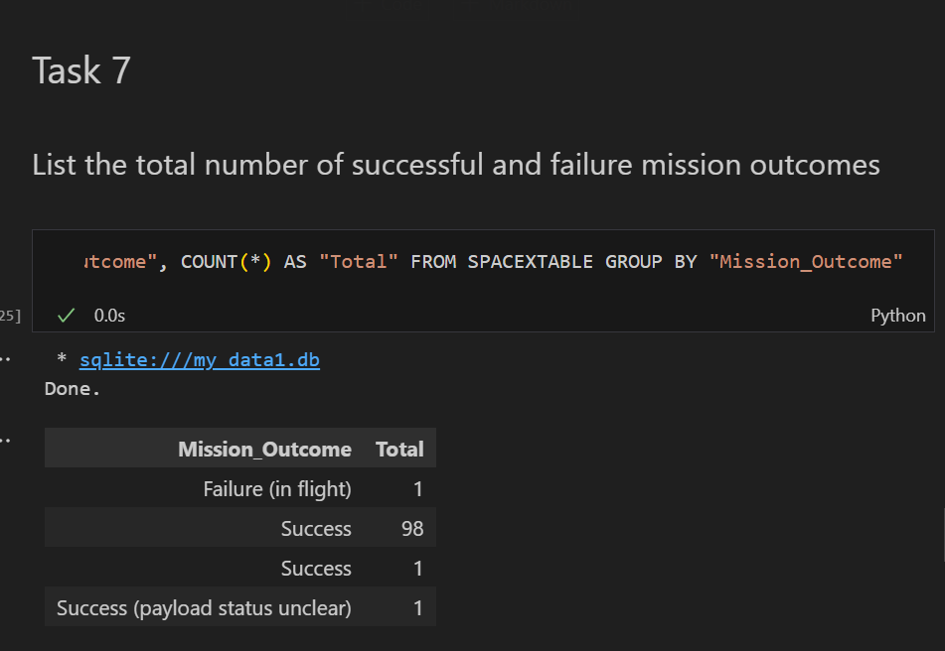
Total Number of Successful and Failure Mission Outcomes
We used Select and GROUP Byto determine if MissionOutcome was a success or a failure.

Slide 31
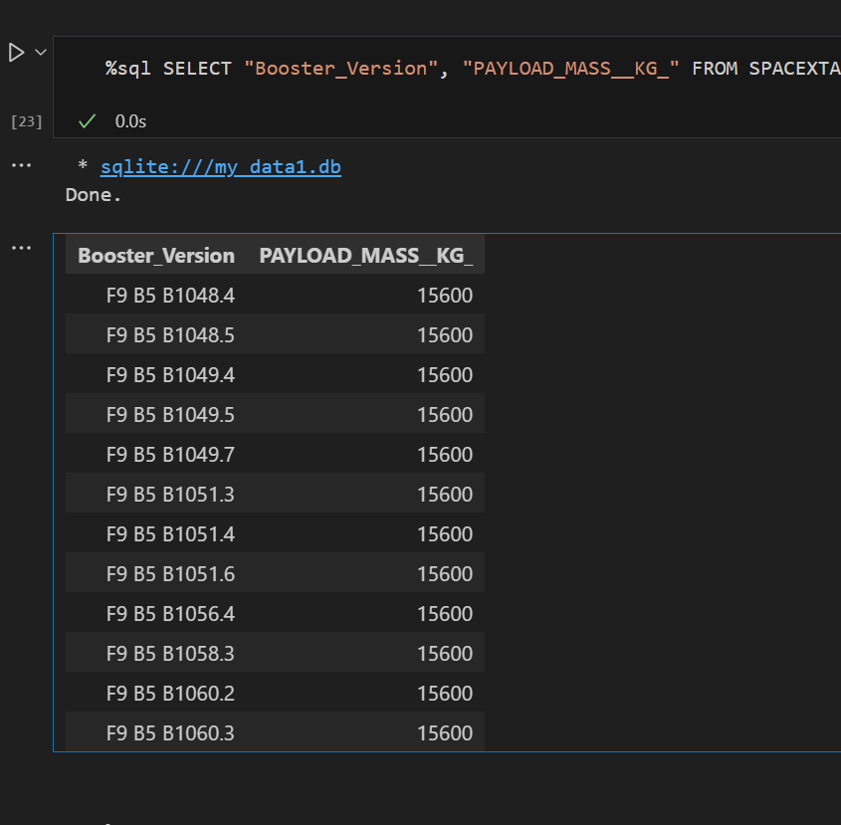
Boosters Carried Maximum Payload
The booster that has carried the maximum payload using a subquery in the WHERE clause and the MAX() function.

Slide 32
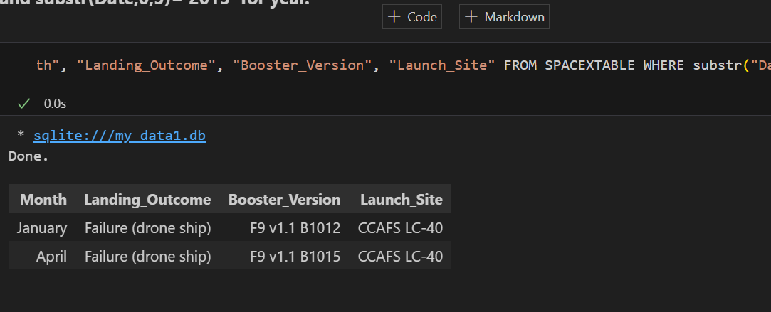
In order to filter for failure landing outcomes in drone ship, their booster versions, and launch location names for the year 2015, we combined the WHERE clause, LIKE, AND, and BETWEEN conditions.
2015 Launch Records
In order to filter for failure landing outcomes in drone ship, their booster versions, and launch location names for the year 2015, we combined the WHERE clause, LIKE, AND, and BETWEEN conditions.

Slide 33
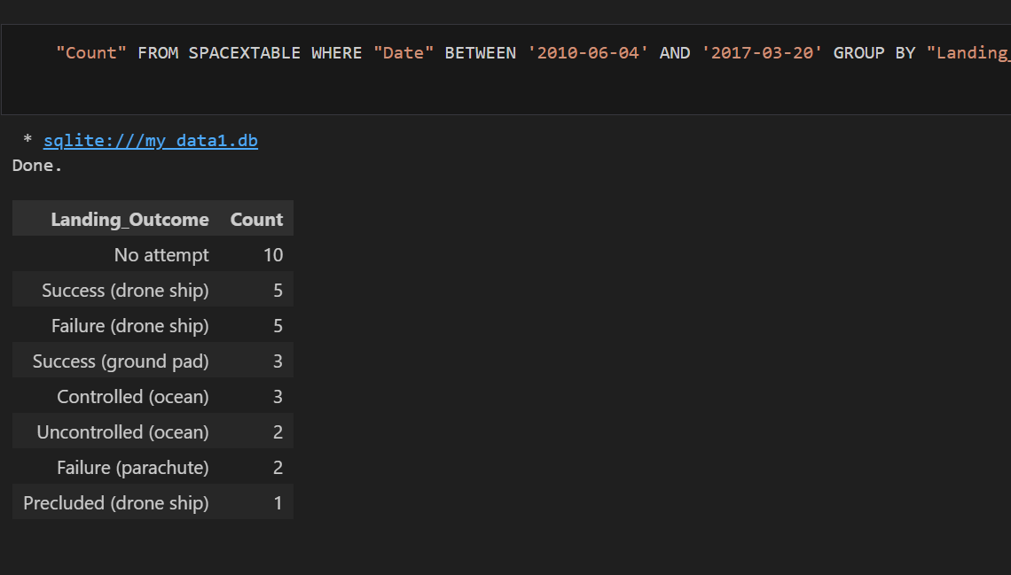
Using the WHERE clause, we filtered the data for landing outcomes BETWEEN 2010-06-04 and 2010-03-20. We also picked the landing outcomes and the COUNT of landing outcomes. The landing outcomes were sorted using the GROUP BY clause, and the grouped landing outcomes were then arranged in descending order using the ORDER BY clause.
Rank Landing Outcomes Between 2010-06-04 and 2017-03-20
Using the WHERE clause, we filtered the data for landing outcomes BETWEEN 2010-06-04 and 2010-03-20. We also picked the landing outcomes and the COUNT of landing outcomes. The landing outcomes were sorted using the GROUP BY clause, and the grouped landing outcomes were then arranged in descending order using the ORDER BY clause.

Slide 34


Slide 35

All launch sites global map markers

Slide 36

Markers showing launch sites with color labels

Slide 37

Launch Site distance to landmarks

Slide 38


Slide 39

Pie chart showing the success percentage achieved by each launch site

Slide 40

Pie chart showing the Launch site with the highest launch success ratio

Slide 41

Scatter plot of Payload vs Launch Outcome for all sites, with different payload selected in the range slider

Slide 42


Slide 43
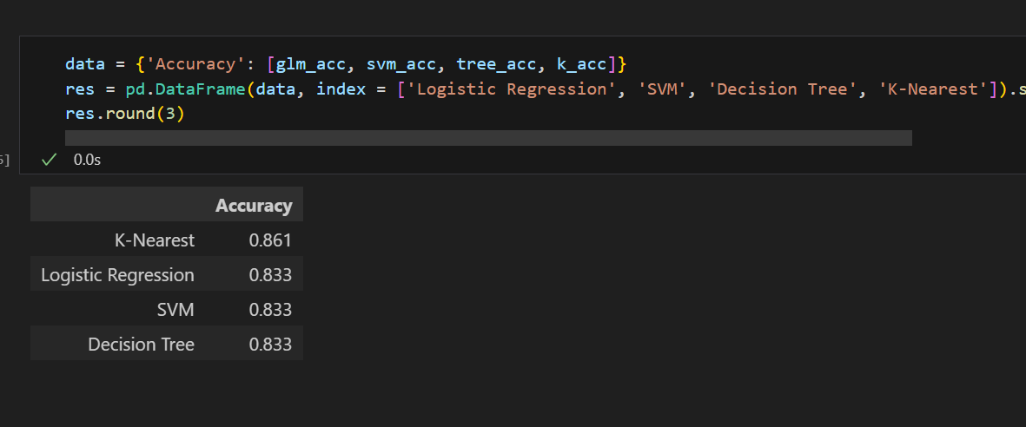
Classification Accuracy
The K-nearest classifier is the model with the highest classification accuracy

Slide 44

Confusion Matrix
The confusion matrix for the k-nearest classifier shows that the classifier can tell the difference between different classes. The major problem is the false positives .i.e., unsuccessful landing marked as successful landing by the classifier.

Slide 45
Conclusions
We can draw the following conclusion: A launch site's success rate increases with the number of flights conducted there. The launch success rate increased from 2013 to 2020. Orbits with the highest success rate were ES-L1, GEO, HEO, SSO, and VLEO. Out of all the sites, KSC LC-39A had the most successful launches. For this problem, the optimal mchine learning algorithm is the decision tree classifier.

Slide 46


